Slide 1
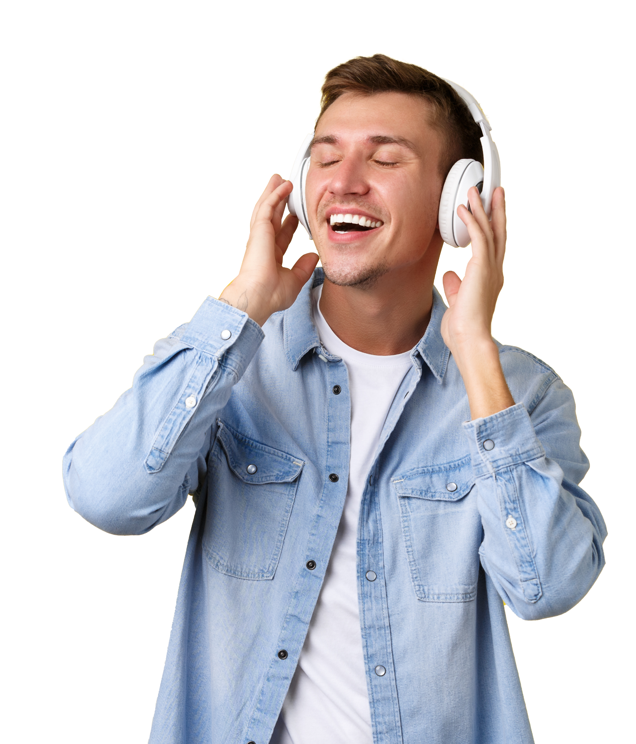


Spotify Songs
Sophie
Darryl
Natalie
Jaspreet

Slide 2
The aim of this project is to develop our current understanding of interactive visualization languages in order to create a usable dashboard for users to check out what’s happening on Spotfiy right now !
Project overview

Slide 3
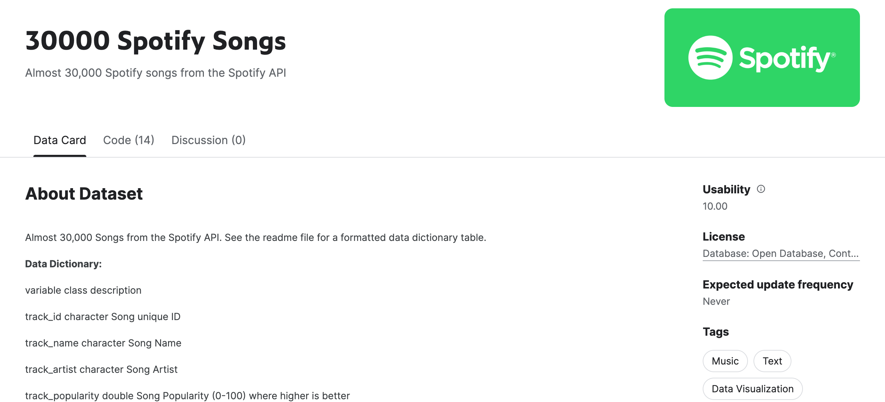



PROJECT 3
Our Data
Our Data
Our Methodology
Creating the flask
Flask diagram
Visualisations
Project evaluation
Trending
Help
SOURCE: https://www.kaggle.com/datasets/joebeachcapital/30000-spotify-songs
Report History

Slide 4

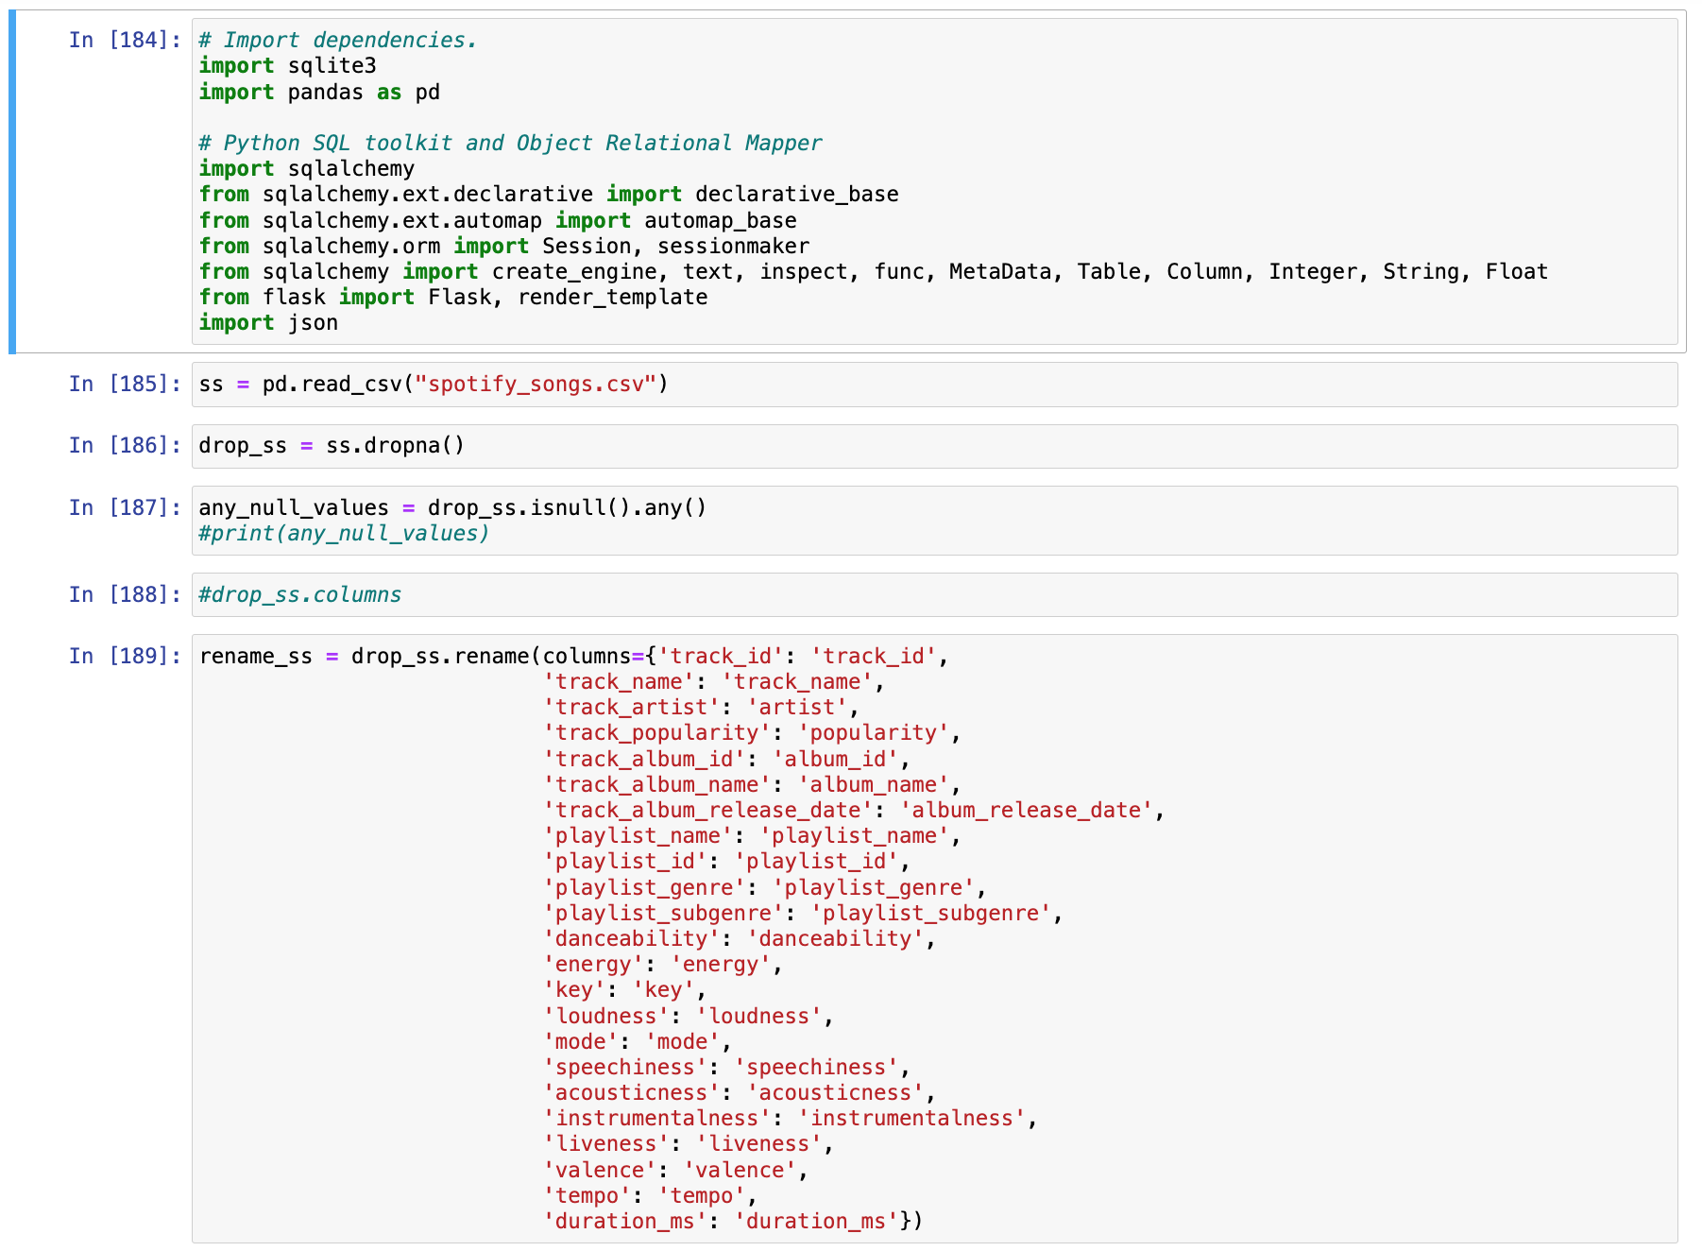
PROJECT 3
Our Methodology
Our Data
Cleaned data on Jupyter Notebook
Created our SQLite connection
Generated our .json file to hold the data
Created our flask route
Worked on our visualisations
Our Methodology
Creating the flask
Flask diagram
Visualisations
JUPYTER NOTEBOOK CODE //
Project evaluation
Trending
Help
Report History

Slide 5
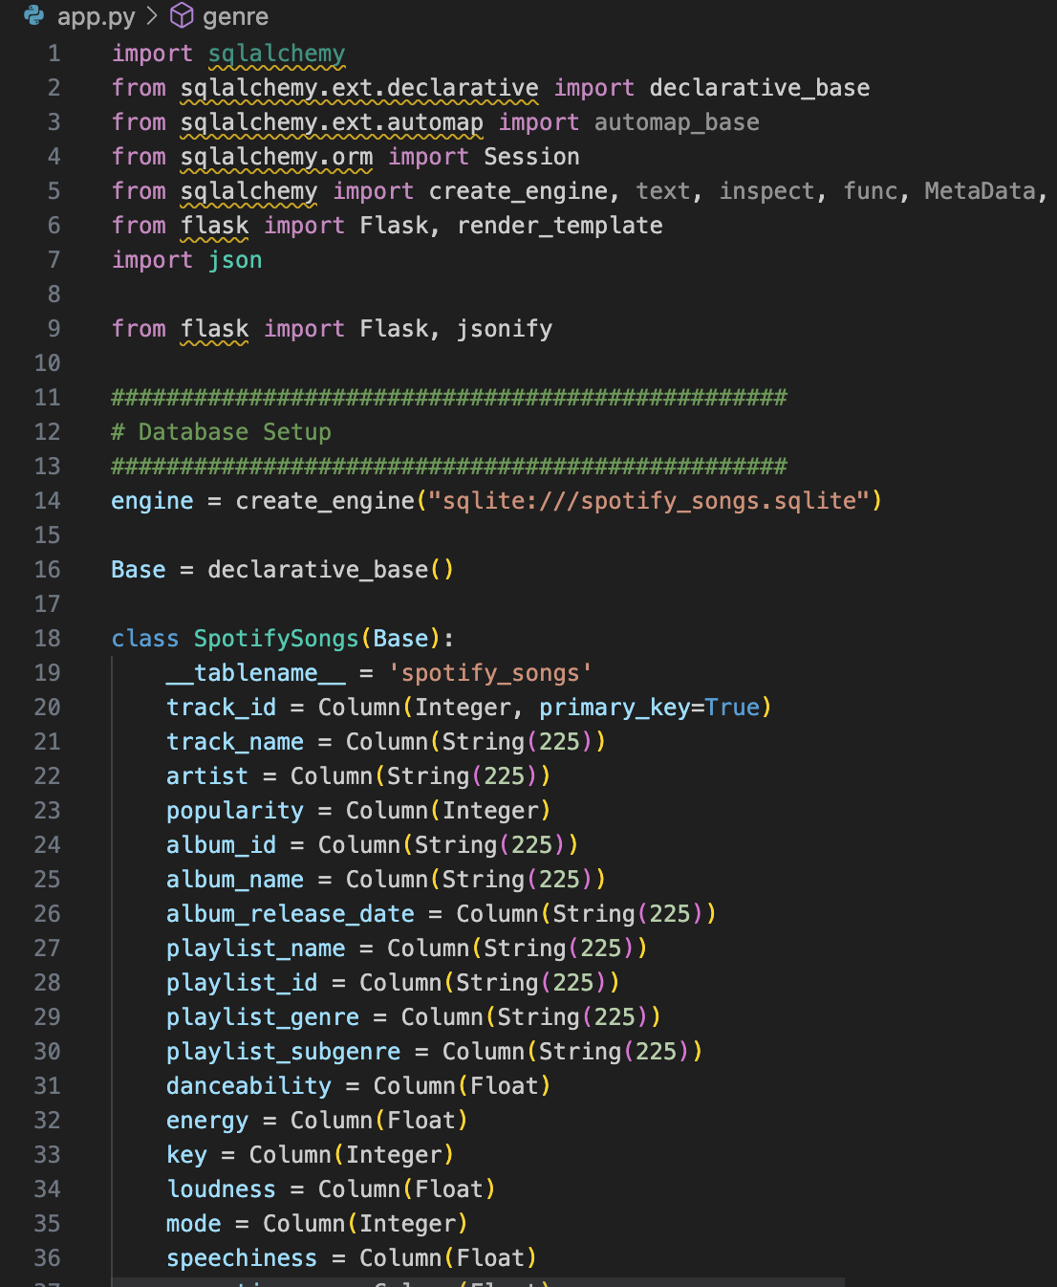

PROJECT 3
Creating the Flask
Our Data
We created this flask to be the primary base in the development of our dashboard.
It is used in the database set up using SQLite and to return a useable .json file.
Our Methodology
Creating the flask
Flask diagram
Visualisations
Project evaluation
Trending
Help
Report History

Slide 6
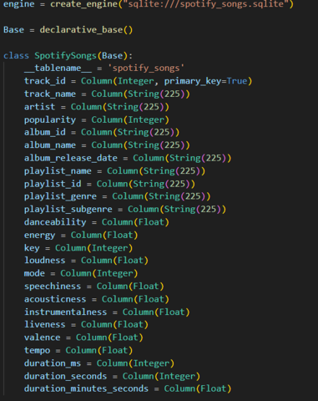
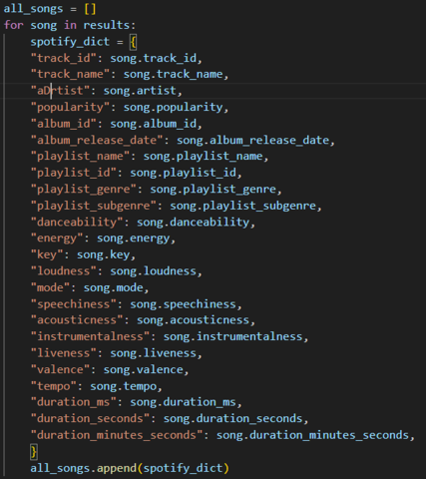
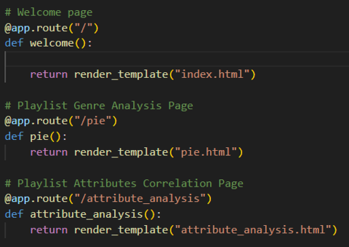
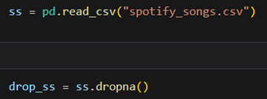
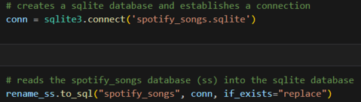
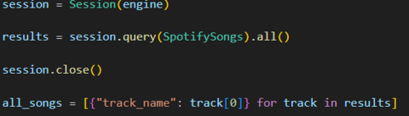

Slide 7
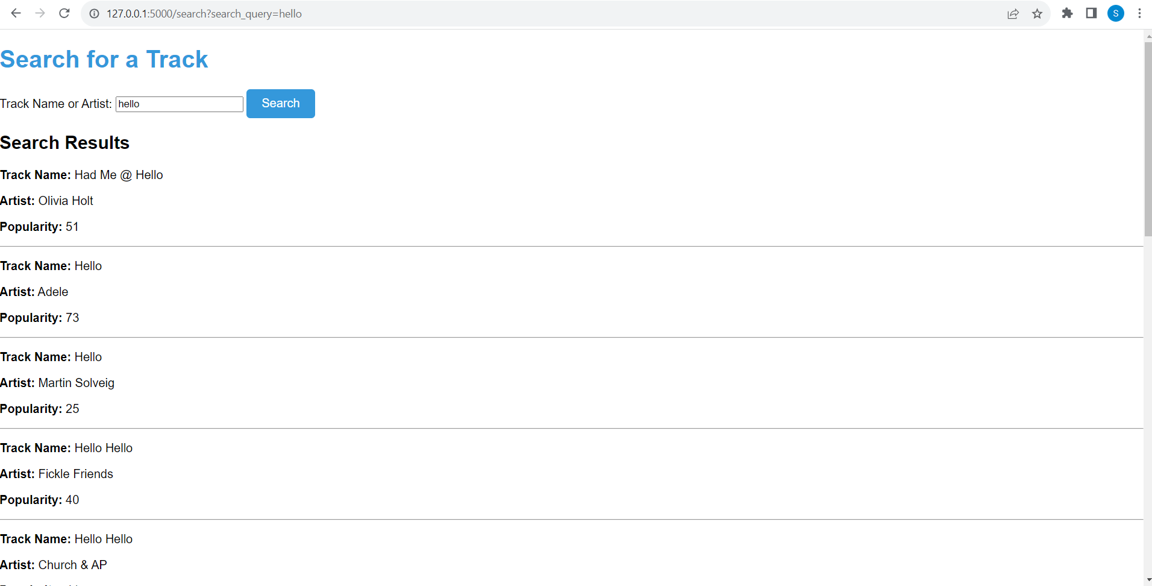
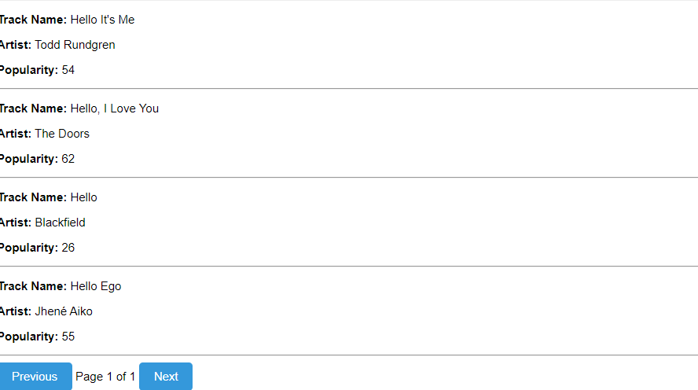
First Visual
PROJECT 3
Search Bar
Our Data
This interactive search bar highlights the key word(s) mentioned and lists the relative items in list format, showcasing the track name, artist, and popularity.
The buttons below allows you to look through pages of our extensive data !
Our Methodology
Creating the flask
Flask diagram
Visualisations
Project evaluation
Trending
Help
Report History

Slide 8
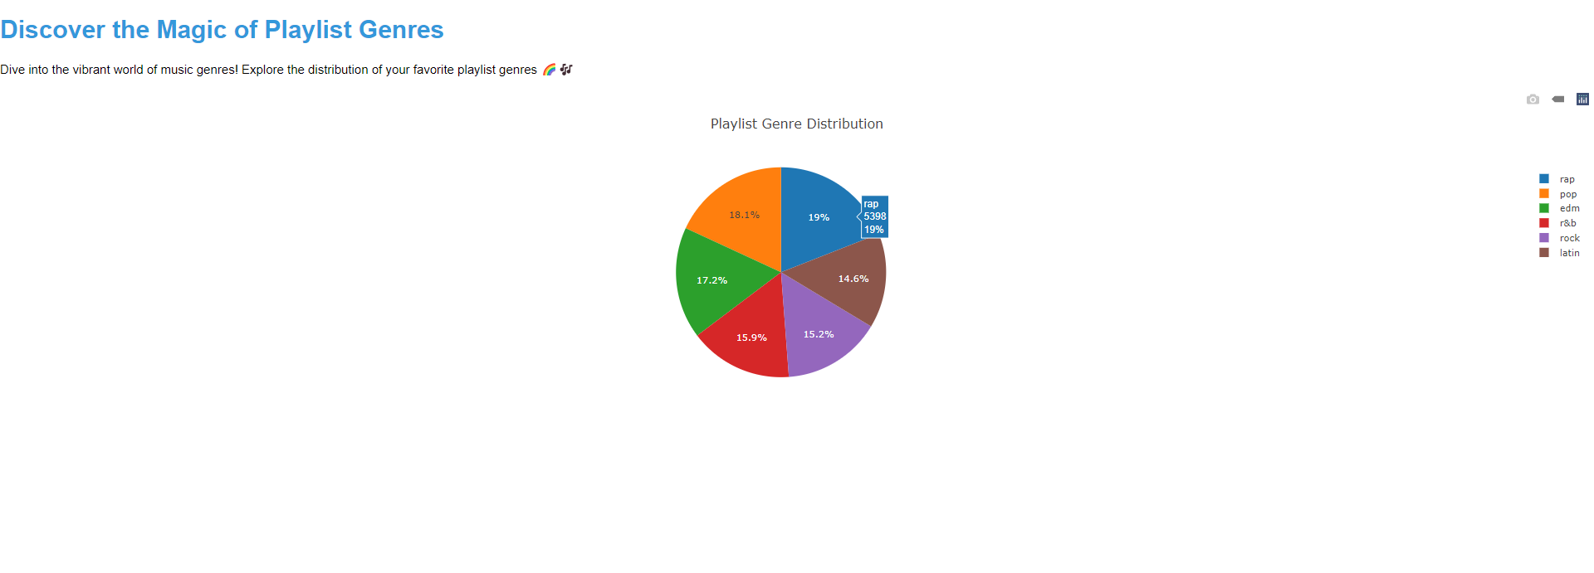
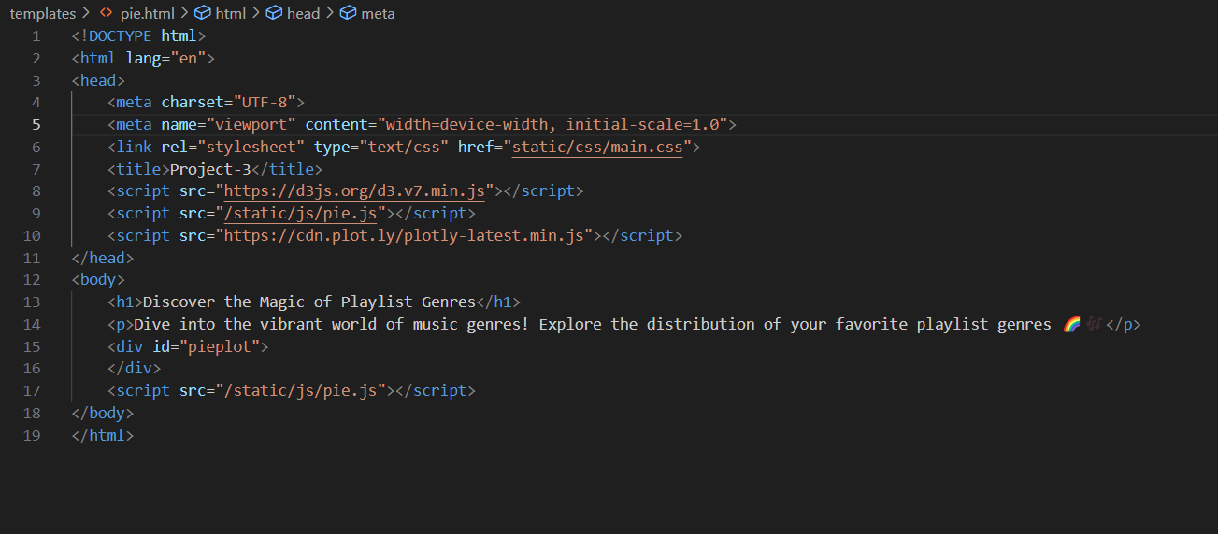
Second Visual
PROJECT 3
Playlist Genres
Our Data
In this section, we have created this dynamic pie chart to illustrate the genre distribution in the database.
We used plotly and d3 libraries to create this informative graph
Our Methodology
Creating the flask
Flask diagram
Visualisations
Project evaluation
Trending
Help
Report History

Slide 9
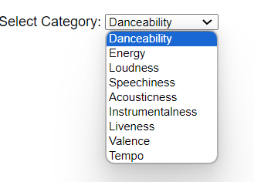
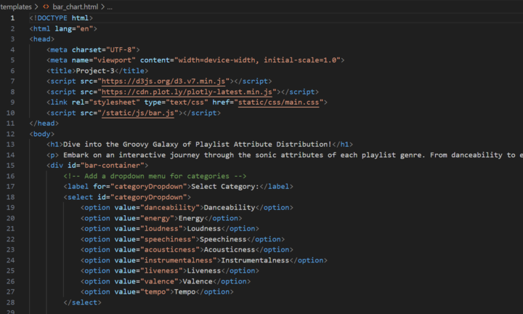
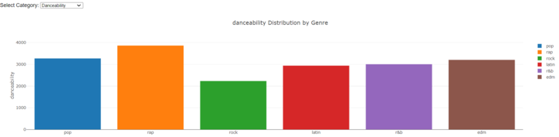
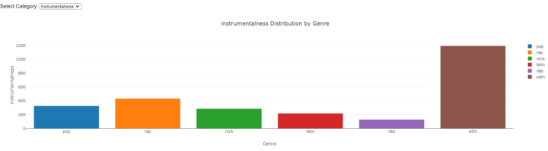
Third Visual
PROJECT 3
Genre Attribution
Our Data
Each song has its own varying levels of attributes, for example danceability and acousticness, these can be quantified and analysed to establish a genre’s unique qualities. These are shown in these bar charts. The genre in question can be deciphered from the dropdown menu
Our Methodology
Creating the flask
Flask diagram
Visualisations
Project evaluation
Trending
Help
Report History

Slide 10
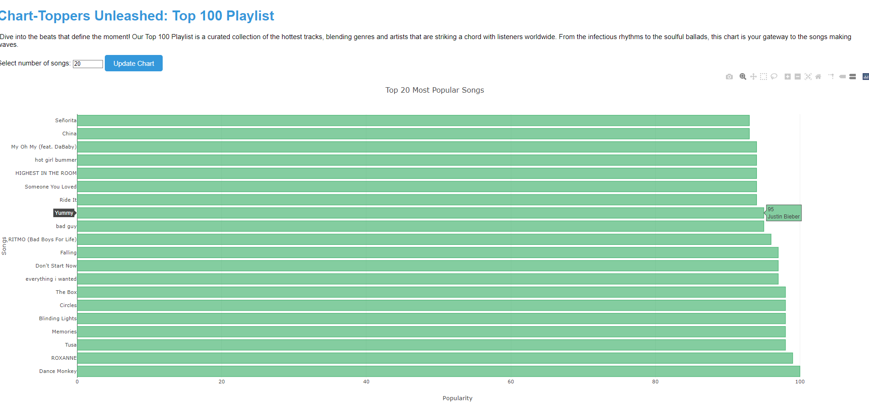
Fourth Visual
PROJECT 3
Top 100
About Us
This customisable graph allows a user to choose the amount of songs they want to check out and rank them according to popularity!
Our Album
Playlist
Artists
Podcasts & Shows
Your Library
Trending
Help
Report History

Slide 11
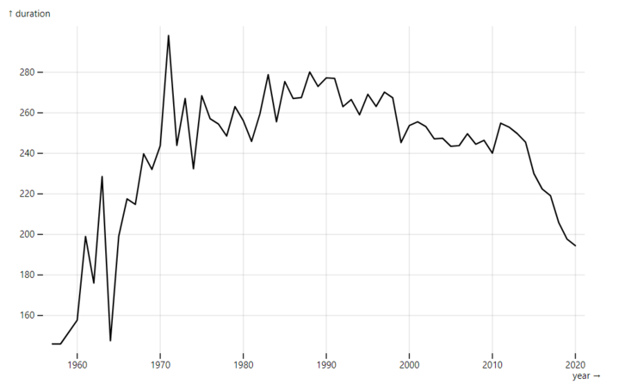
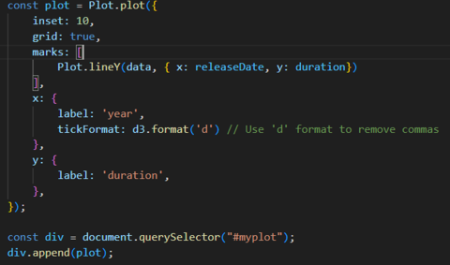
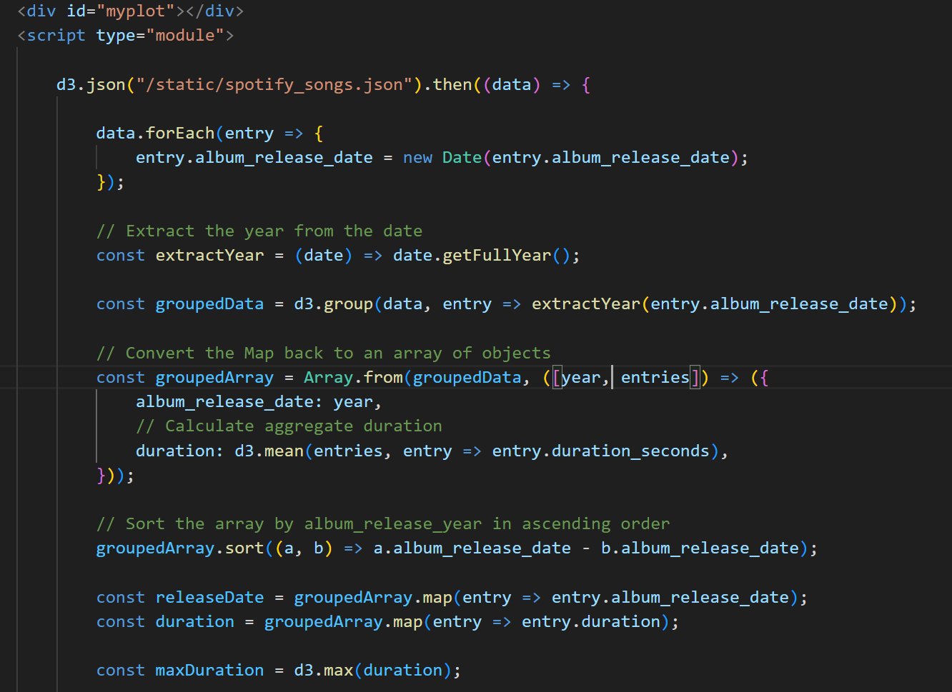
Fifth Visual
PROJECT 3
Song Length
To create this graph we used another library called Observable to denote the duration of songs over time!
As shown here the length of songs have generally decreased over time
About Us
Our Album
Playlist
Artists
Podcasts & Shows
Your Library
Trending
Help
Report History

Slide 12
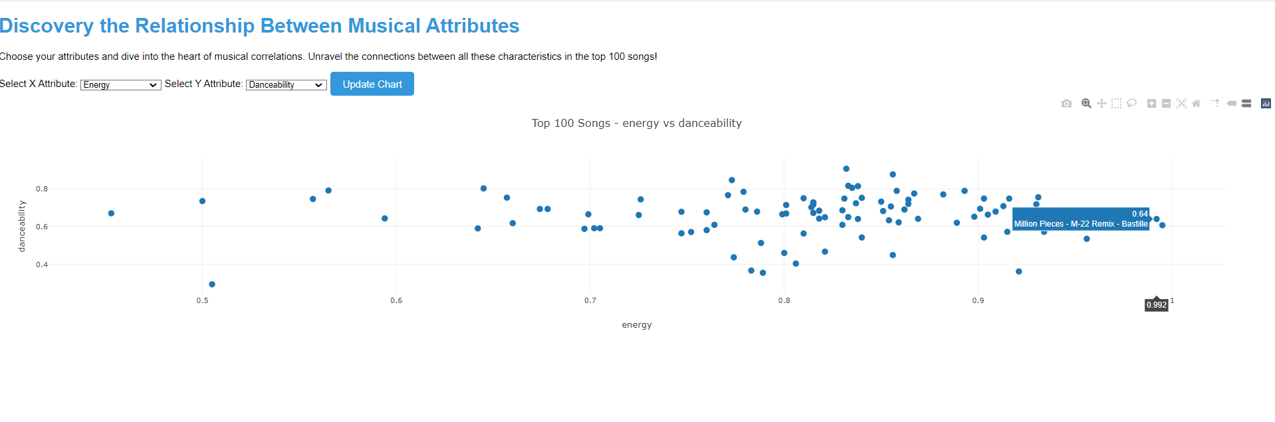
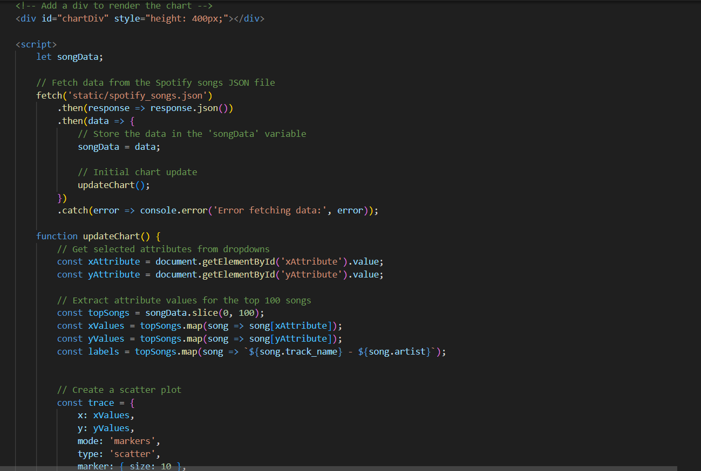
Sixth visual
PROJECT 3
Attribute Relations
About Us
This is a fun interactive feature of our dashboard where users can pick two attributes of their choice in the dropdown menus and they can create a scatter graph highlighting the musical correlations
Our Album
Playlist
Artists
Podcasts & Shows
Your Library
Trending
Help
Report History

Slide 13
PROJECT 3
Project Evaluation
About Us
Upon reflection there are some topics that are definitely worth delving into, for example looking into how spotify uses individual data to curate personalised playlists
Or we could create detailed dynamic visulisations using other libraries like chart.js, for example to further explain and analyse our data
Our Album
Playlist
Artists
Podcasts & Shows
Your Library
Trending
Help
Report History

Slide 14

Thank You
Keep streaming!

